Slide 1
CSS (Cascading Style Sheets)
Marco A. Adarme Jaimes
(madarme@ufps.edu.co)
A

Slide 2
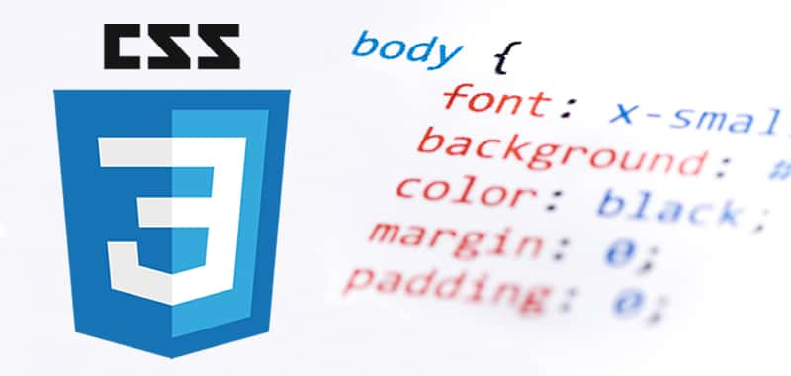
Introducction (CSS)
A style sheet language, or style language, is a computer language that expresses the presentation of structured documents. CSS is designed to enable the separation of presentation and content, including layout, colors, and fonts. This separation can improve content accessibility, provide more flexibility and control in the specification of presentation characteristics, enable multiple web pages to share formatting by specifying the relevant CSS in a separate .css file, and reduce complexity and repetition in the structural content.
The name cascading comes from the specified priority scheme to determine which style rule applies if more than one rule matches a particular element. This cascading priority scheme is predictable.
CSS was first proposed by Håkon Wium Lie on October 10, 1994. At the time, Lie was working with Tim Berners-Lee at CERN.

Slide 3
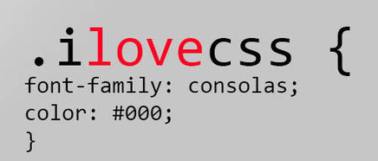
Introducction (CSS)
CSS enables to change the appearance and presentation only by editing a file
CSS enables us to make all pages of our website look similar and consistent.
External style files from information and a lot of work is saved

Slide 4
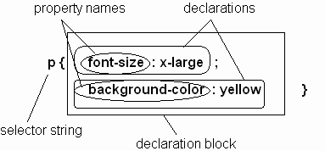
CSS Syntax
Parts of a style rule (or statement)
It based on: http://www.site.uottawa.ca/~gvj/Courses/CSI3140/lectures/CSS.ppt

Slide 5
Three Ways to Use CSS
We can add CSS code in any combination of three different ways:
Inline Style - CSS code is placed directly into an XHTML element within the <body> section of a web page.
Internal Style Sheet - CSS code is placed into a separate, dedicated area within the <head> section of a web page.
External Style Sheet - CSS code is placed into a separate computer file and then linked to a web page.
It based on: georgejenkinshs.com/wp-content/.../6.-Introduction-to-CSS.ppt

Slide 6
Inline Style
To define an inline CSS style, we simply add the style attribute to an XHTML element with the CSS declaration as the attribute value:
An inline style declaration is highly specific and formats just one element on the page. No other elements, including other <h2> elements on the page, will be affected by this CSS style.

Slide 7
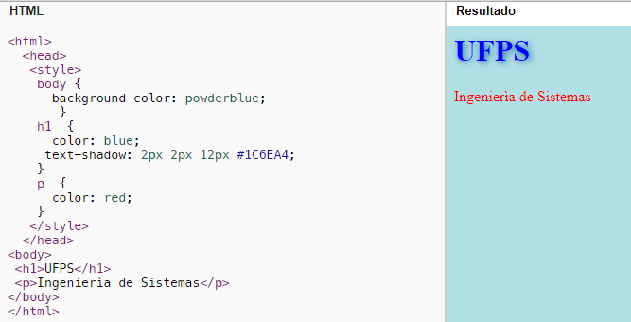
Internal Style Sheet
To use an internal CSS style sheet, we add a <style> section within the <head> of the page. All our CSS declarations go within this section:
Styles declared in the internal style sheet affect all matching elements on the page. In this example, all <h2> page elements are displayed in the color red. Since formatting declarations are entirely in the <head> section, away from the actual page content, internal CSS style sheets do a much better job than inline styles at separating content from presentation.
It based on: http://www.site.uottawa.ca/~gvj/Courses/CSI3140/lectures/CSS.ppt

Slide 8
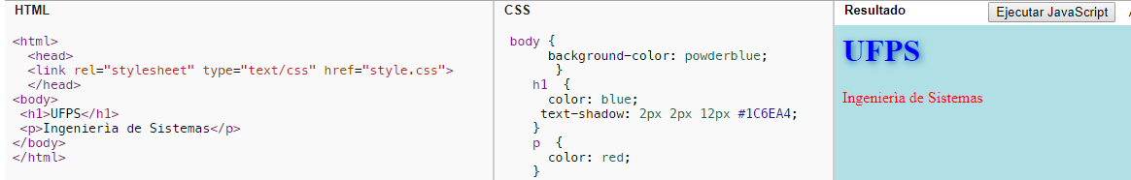
External Style Sheet
To use an external CSS style sheet, we create a new file (with a .css extension) and write our style declarations into this file. We then add a <link> element into our HTML file, right after the opening <head> tag:
index.html file:
style.css (separate file):
The <link> element instructs the browser to load the external file specified by the href attribute and to apply the CSS style declarations contained there.

Slide 9

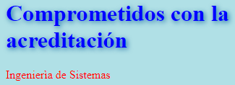
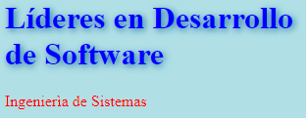
Benefit of External Style Sheet
The real power of using an external style sheet is that multiple web pages on our site can link to the same style sheet:
style.css
page1.html
page2.html
page3.html
Styles declared in an external style sheet will affect all matching elements on all web pages that link to the style sheet. By editing the external style sheet, we can make site-wide changes (even to hundreds of pages) instantly.

Slide 10
Internal vs. External Style Sheets
Internal Style Sheets:
are appropriate for very small sites, especially those that have just a single page.
might also make sense when each page of a site needs to have a completely different look.
Internal or Extenal?????
External Style Sheets:
are better for multi-page websites that need to have a uniform look and feel to all pages.
make for faster-loading sites (less redundant code).
allow designers to make site-wide changes quickly and easily.

Slide 11
What Does "Cascading" Mean?-1
We use the term "cascading" because there is an established order of priority to resolve formatting conflicts:
Inline style (highest priority)
Internal style sheet (second priority)
External style sheet (third priority)
Web browser default (only if not defined elsewhere)
For each XHTML element, the browser will see which styles are defined inline and from internal and external style sheets. For any conflicts detected, it will use this priority system to determine which format to display on the page.
In the prior example, the heading text would display in the color specified by the inline style, which outranks all the others.
If multiple, conflicting styles are defined in the same style sheet, only the final one will be applied. Be careful, as this is another common mistake committed by beginners.
It based on: http://www.site.uottawa.ca/~gvj/Courses/CSI3140/lectures/CSS.ppt

Slide 12

What Does "Cascading" Mean?-2
<html>
<head>
<style>
h1 {
color: blue;
text-shadow: 2px 2px 12px #1C6EA4;
}
</style>
<title>Esto es un ejemplo</title>
</head>
<body>
<h1 style="color: red">UFPS</h1>
</body>
</html>
☹
“only color attribute”
☺

Slide 13

What Does "Cascading" Mean?-3
<html>
<head>
<style>
h1 {
color: blue !important;
text-shadow: 2px 2px 12px #1C6EA4;
}
</style>
<title>Esto es un ejemplo</title>
</head>
<body>
<h1 style="color: red">UFPS</h1>
</body>
</html>
☺
“only color attribute”
☹

Slide 14
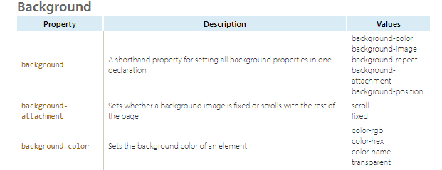
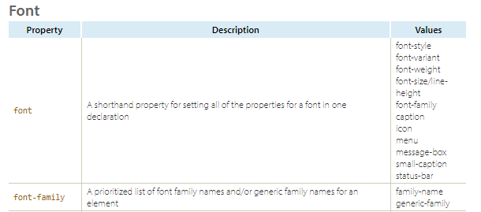
CSS Properties Reference List
http://www.stylinwithcss.com/resources_css_properties.php

Slide 15
CSS Syntax: Selector Strings-1
Single element type:
Multiple element types:
All element types:
Specific elements by id:

Slide 16
CSS Syntax: Selector Strings
Single element type:
Multiple element types:
All element types:
Specific elements by id:

Slide 17

Classes and IDs
At first glance, classes and IDs appear to function identically, but there are important differences between the two:
IDs can be applied to one and only one element in a web document.
Classes can be applied to an unlimited number of elements, even different types of elements on the same page.
If conflicting styles from an ID and class are applied to the same element, the ID will outrank the class in the cascade.
It based on: http://www.site.uottawa.ca/~gvj/Courses/CSI3140/lectures/CSS.ppt

Slide 18
The Need for Classes and IDs
Recall our prior example of using CSS to style three paragraph elements differently:
<p>Normal text</p>
<p style="font-weight:bold;">UFPS 1</p>
<p style="font-style:italic;">UFPS 2</p>
<p style="font-weight:bold;font-style:italic;">UFPS 3</p>
We had to use the inline style for these paragraphs. If we had attempted to style the <p> element in an internal or external style sheet, the formatting rules would have applied to all the <p> elements, not specific ones ☹.

Slide 19
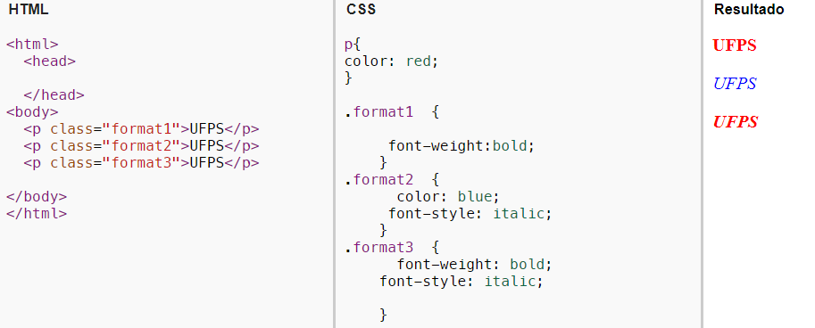
Example: Classes

Slide 20
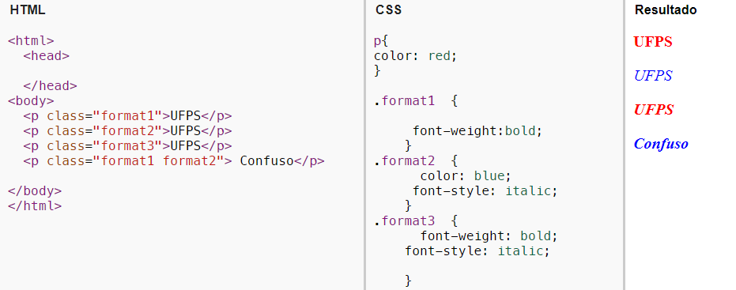
Example: Multiple Classes
☹
☺

Slide 21
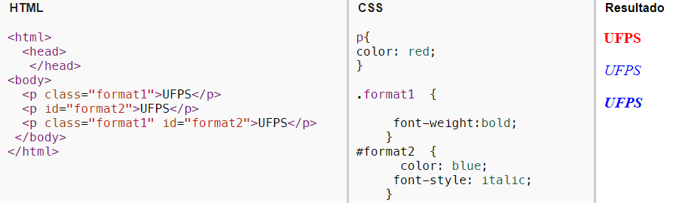
Example: Class and ID, Same Element
Remember that "id" can be used by only one element.

Slide 22
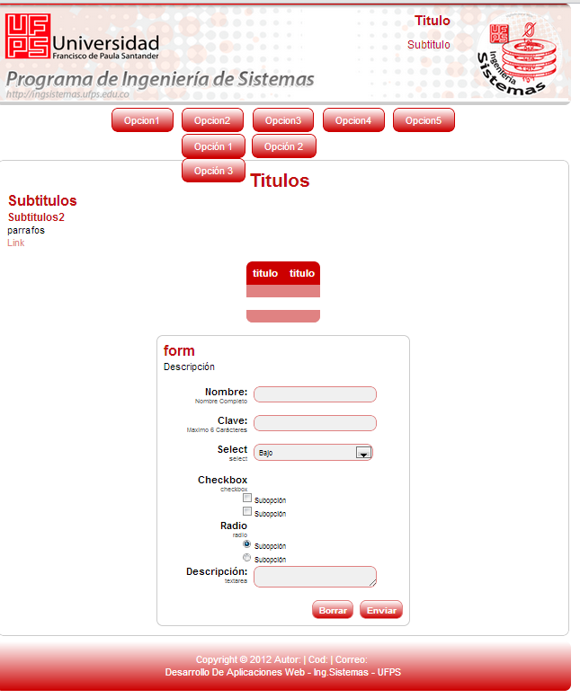
EXAMPLE- USING CSS (UFPS FORMAT)
Encabezado-Llamado del css
Banner (Títulos y subtítulos)
Menús-submenús
Cuerpo o contenido
Parrafos
Listas
Tablas
Formularios
Pie de página

Slide 23
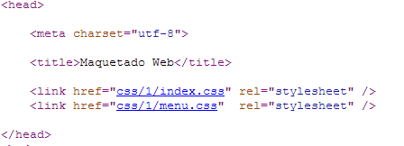
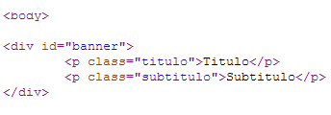
EXAMPLE- USING CSS (UFPS FORMAT)
Encabezado-Llamado del css
Banner (Títulos y subtítulos)

Slide 24
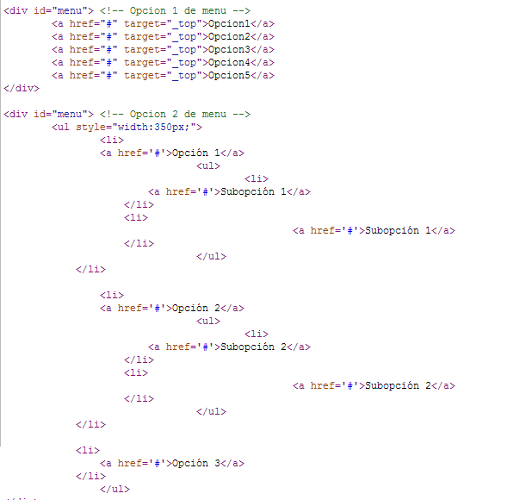
EXAMPLE- USING CSS (UFPS FORMAT)
Menús y Submenús

Slide 25
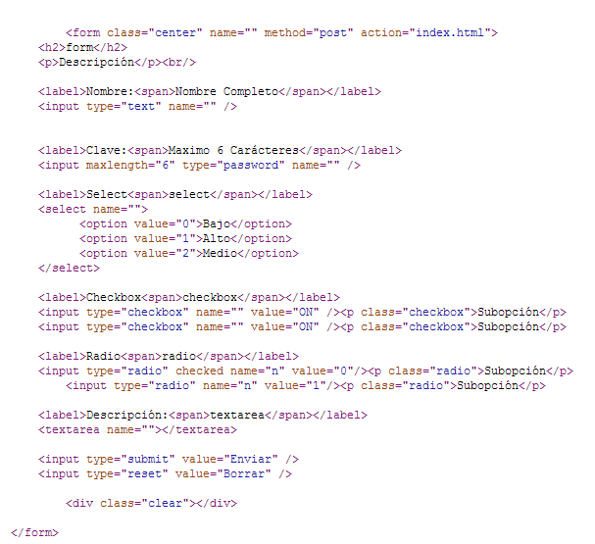
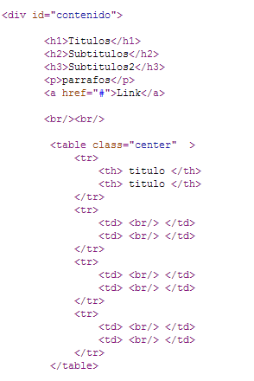
EXAMPLE- USING CSS (UFPS FORMAT)
Cuerpo o contenido
<body>
Uso de tablas
Uso de formularios

Slide 26
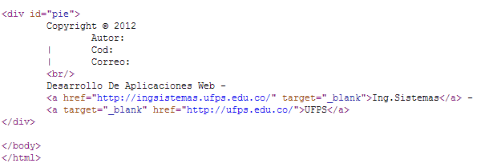
EXAMPLE- USING CSS (UFPS FORMAT)
Cuerpo o contenido
Pie de página

Slide 27
Thanks
Email: madarme@ufps.edu.co
Consulting Schedule: Mon & Wed 3-5pm.

